Slide 1


Practice Video 1
Segmentation: Optimal Pricing in Two Markets
Professor Nico Voigtländer
Management 405: Module 6

Slide 2
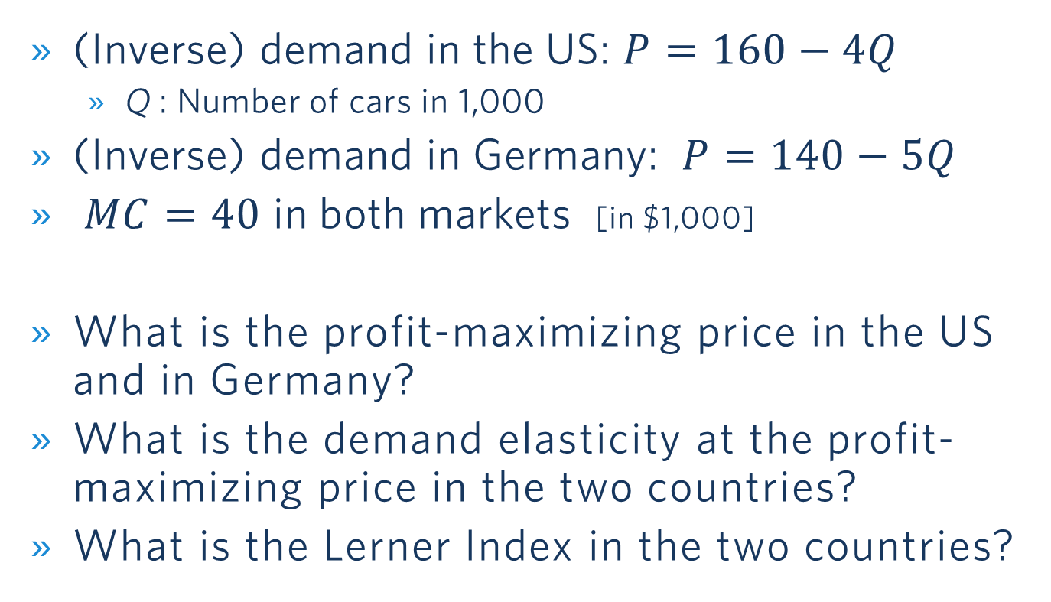
BMW and Segmentation
(Inverse) demand in the US: $P=160−4Q$
  Q : Number of cars in 1,000
(Inverse) demand in Germany: $P=140−5Q$
$MC=40$ in both markets [in $1,000]
What is the profit-maximizing price in the US and in Germany?
What is the demand elasticity at the profit-maximizing price in the two countries?
What is the Lerner Index in the two countries?

Slide 3
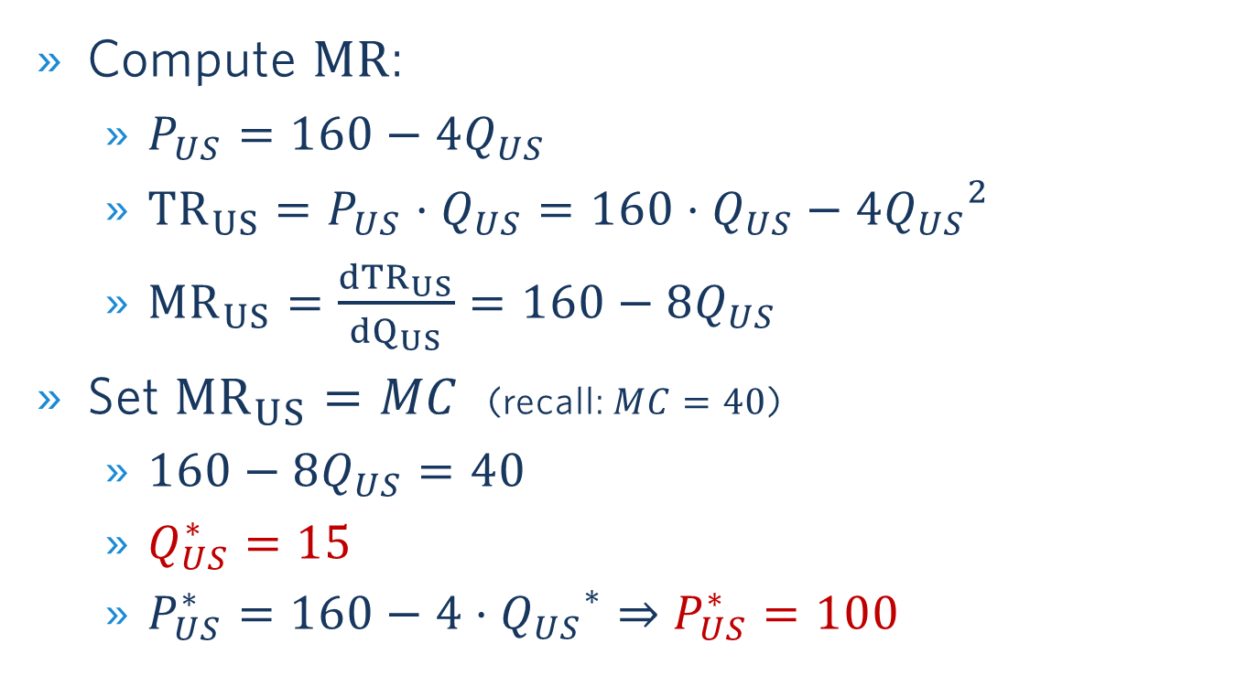
Profit-Maximization In the US Market
Compute $MR$:
  $P_{US}=160−4Q_{US}$
  ${TR}_{US}=P_{US}⋅Q_{US}=160⋅Q_{US}−4{Q_{US}}^{2}$
  ${MR}_{US}=\frac{{dTR}_{US}}{{dQ}_{US}}=160−8Q_{US}$
Set ${MR}_{US}=MC$ (recall: $MC=40$)
  $160−8Q_{US}=40$
  $Q_{US}^{∗}=15$
  $P_{US}^{∗}=160−4⋅{Q_{US}}^{∗}⇒$ $P_{US}^{∗}=100$

Slide 4
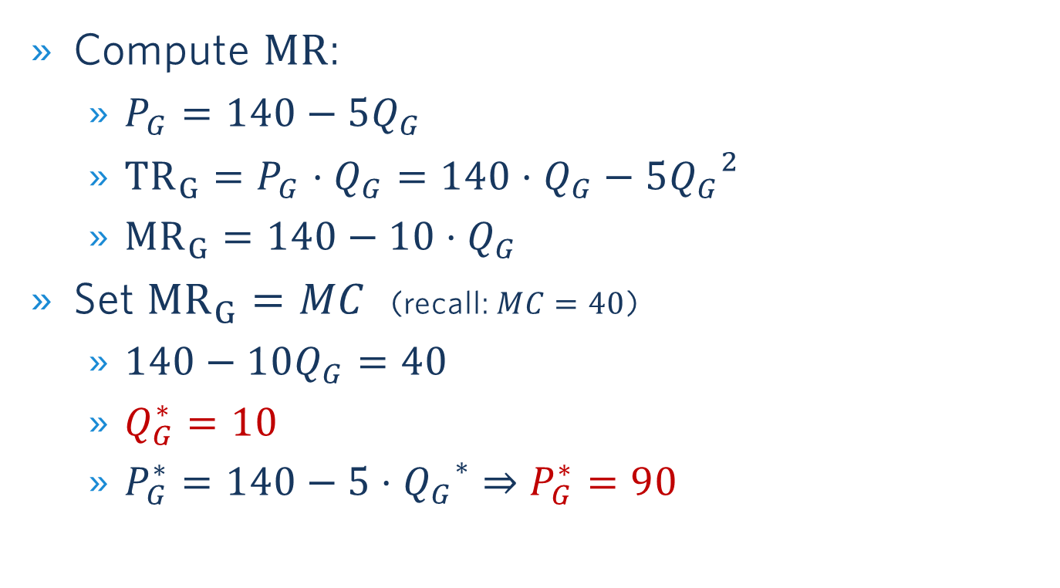
Profit-Maximization In GERMANY
Compute $MR$:
  $P_{G}=140−5Q_{G}$
  ${TR}_{G}=P_{G}⋅Q_{G}=140⋅Q_{G}−5{Q_{G}}^{2}$
  ${MR}_{G}=140−10⋅Q_{G}$
Set ${MR}_{G}=MC$ (recall: $MC=40$)
  $140−10Q_{G}=40$
  $Q_{G}^{∗}=10$
  $P_{G}^{∗}=140−5⋅{Q_{G}}^{∗}⇒$ $P_{G}^{∗}=90$

Slide 5
Illustrating the SOlution

Slide 6
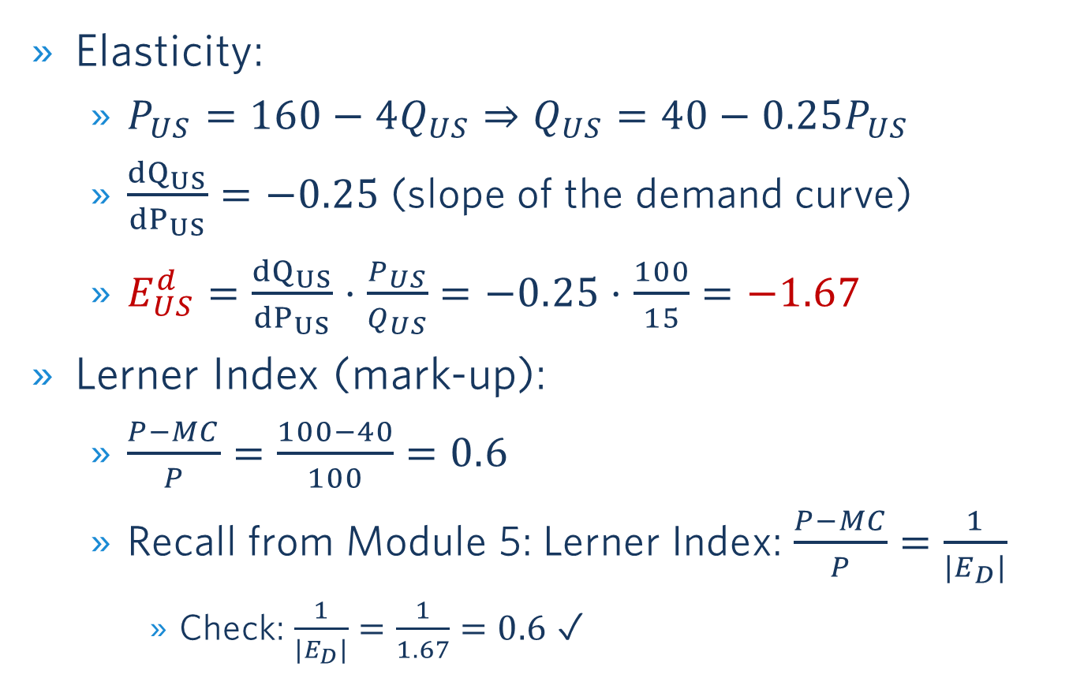
Demand Elasticity and MARK-up: USA
Elasticity:
  $P_{US}=160−4Q_{US}⇒Q_{US}=40−0.25P_{US}$
  $\frac{{dQ}_{US}}{{dP}_{US}}=−0.25$ (slope of the demand curve)
  $E_{US}^{d}=\frac{{dQ}_{US}}{{dP}_{US}}$ $⋅\frac{P_{US}}{Q_{US}}=−0.25⋅$ $\frac{100}{15}=−1.67$
Lerner Index (mark-up):
  $\frac{P−MC}{P}=\frac{100−40}{100}=0.6$
  Recall from Module 5: Lerner Index: $\frac{P−MC}{P}=\frac{1}{{|E}_{D}|}$
    Check: $\frac{1}{{|E}_{D}|}=\frac{1}{1.67}=0.6$ ✓

Slide 7
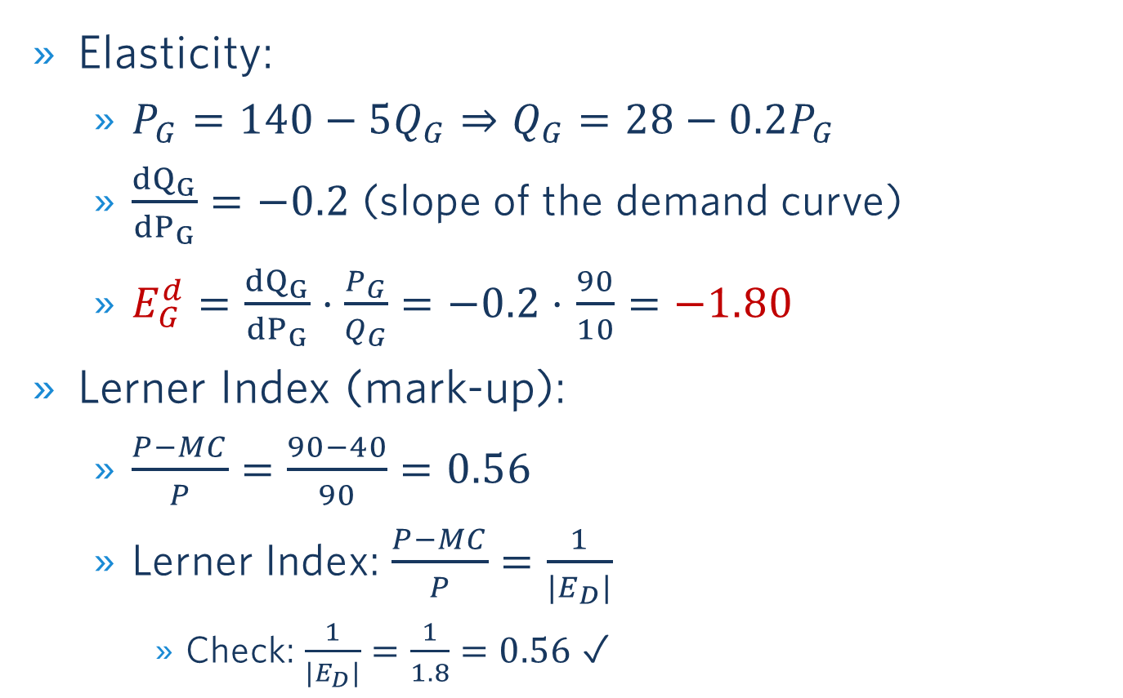
Demand Elasticity and MARK-up: Germany
Elasticity:
  $P_{G}=140−5Q_{G}⇒Q_{G}=28−0.2P_{G}$
  $\frac{{dQ}_{G}}{{dP}_{G}}=−0.2$ (slope of the demand curve)
  $E_{G}^{d}=\frac{{dQ}_{G}}{{dP}_{G}}$ $⋅\frac{P_{G}}{Q_{G}}=−0.2⋅$ $\frac{90}{10}=−1.80$
Lerner Index (mark-up):
  $\frac{P−MC}{P}=\frac{90−40}{90}=0.56$
  Lerner Index: $\frac{P−MC}{P}=\frac{1}{{|E}_{D}|}$
    Check: $\frac{1}{{|E}_{D}|}=\frac{1}{1.8}=0.56$ ✓

Slide 8
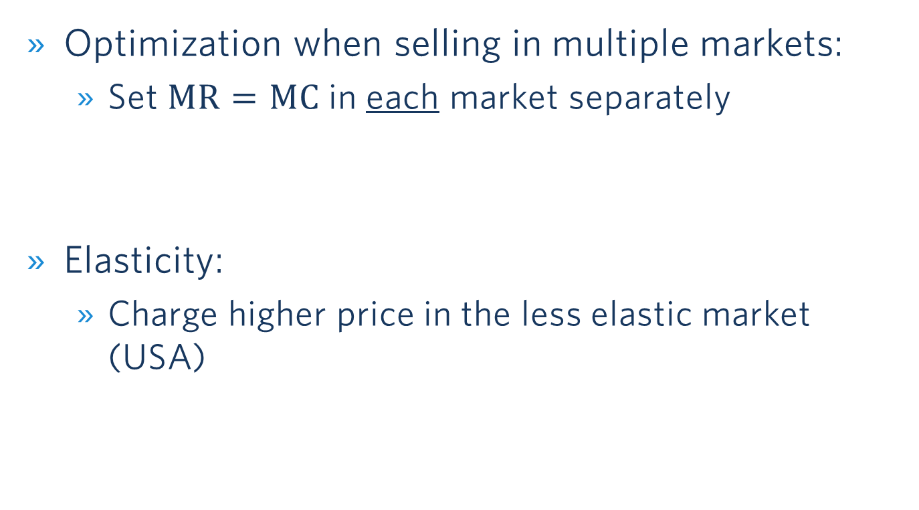
Important Take-Away
Optimization when selling in multiple markets:
  Set $MR=MC$ in each market separately
Elasticity:
  Charge higher price in the less elastic market (USA)

